Slide 1
R for Reporting
Introduction to Shiny
March 12, 2019
KROLL BOND RATING AGENCY, INC

Slide 2
Agenda
What is R
How do you do R
Shiny
Desktop
Server
Cloud

Slide 3
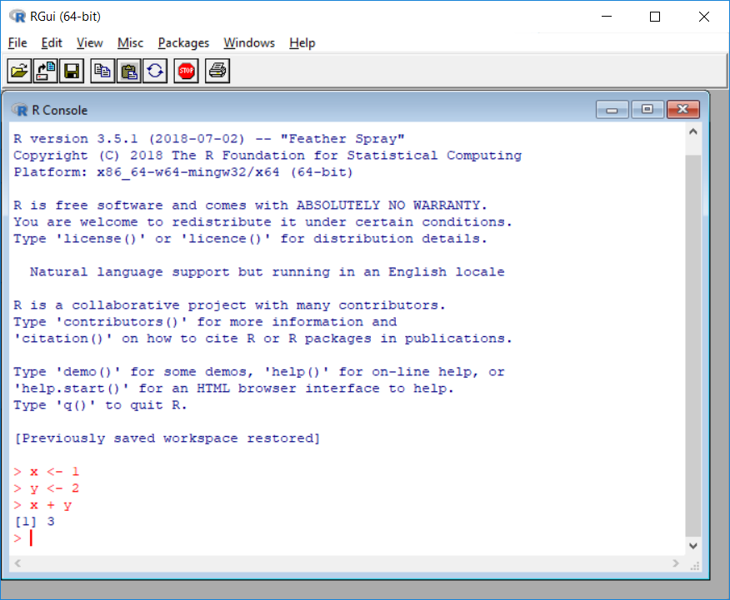
What is R ?
R is a language and environment for statistical computing and graphics.

Slide 4
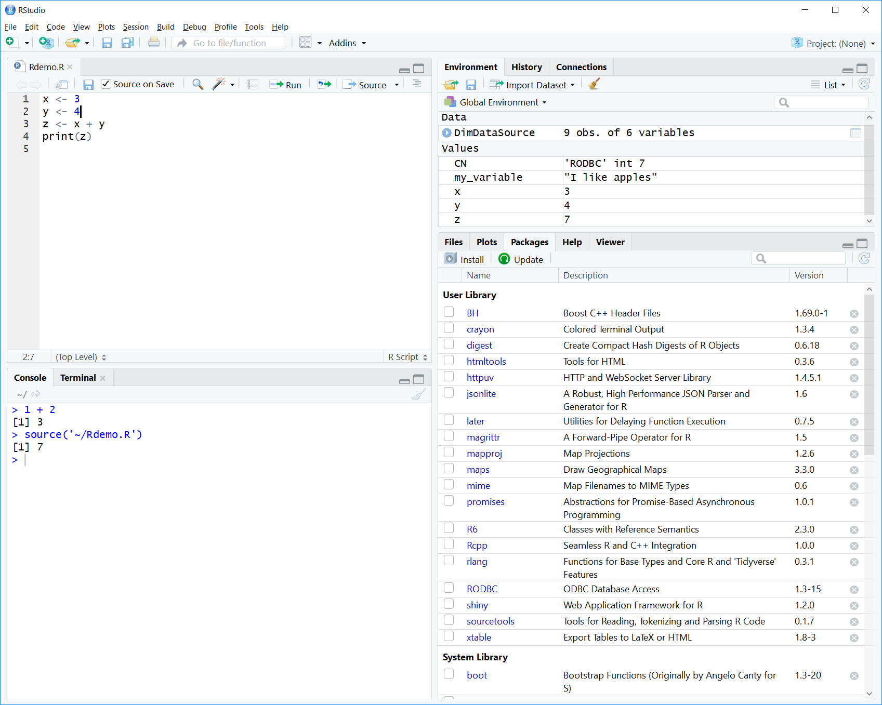
How do you do R?
RStudio

Slide 5
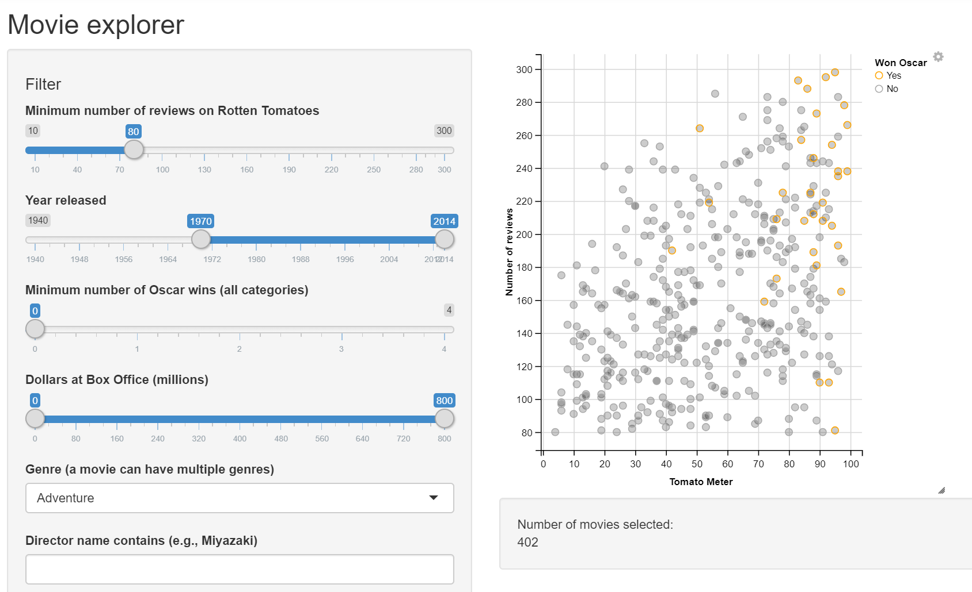
Shiny – Web Application Framework

Slide 6
Shiny – Desktop

